Slide 1
PARALLEL COMPUTING
HEC MONTREAL
ADVANCED STATISTICAL LEARNING
TEAM PROJECT BY –
JULIEN LANTHIER,
ZAKARIA RAYADH,
AKANKHYA MOHAPATRA
PRESENTATION BY –
AKANKHYA MOHAPATRA (11272989)

Slide 2

OVERVIEW
Parallel Computing is the method of running many calculations simultaneously and generating mutually dependent data.
Concepts to be familiar with to understand parallel computing:
Architecture of Parallel Computing
Processing unit to run calculations
Communication between nodes

Slide 3
WHY USE PARALLEL COMPUTING?
Most important of them is, saving time and cost of computing
This brings to second advantage of solving larger problems
Enabling non-local resources for concurrency

Slide 4
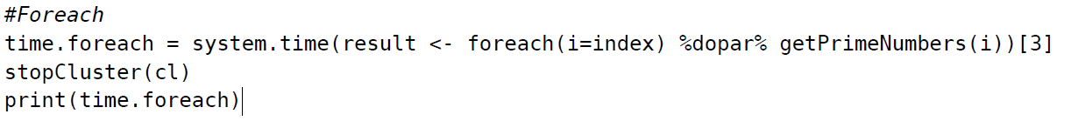
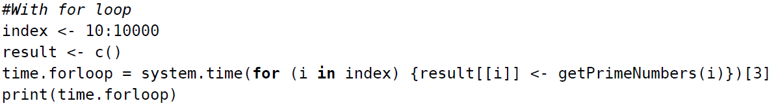
AN EXAMPLE OF FOREACH TO UNDERSTAND HOW TO PROCESS IN PARALLEL
We have taken an example of prime numbers to showcase parallel computing can improve efficiency in performance and produce similar results.
Library parallel -
print(detectCores())
nClust = detectCores(logical = FALSE) print(nClust)
makeCluster(nClust-1)

Slide 5
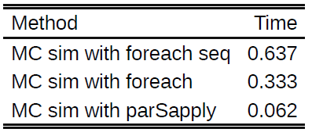
APPLICATION TO MONTE CARLO SIMULATION
Monte Carlo Simulation is a statistical technique which relies on running randomly selected scenarios for every calculation or loop rendering all possible outcomes and the likelihood of each.
Example shown as part of tutorial is a simple simulation for generating 100 random values from a sampled data with 10000 no of draws.
It compares serial computing with parallel computing using foreach-dopar and parSapply.

Slide 6

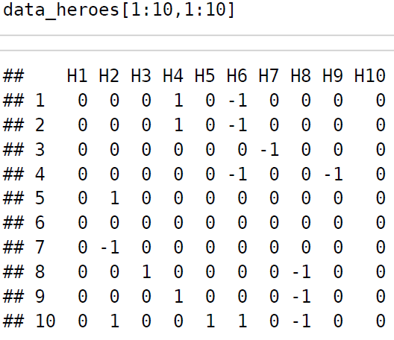
ILLUSTRATION ON REAL DATA (Dota2 Games Results)
TARGET : Find the most played hero trio
CHALLENGE: Cannot compare column by itself as comparison of I with j col will result same as j with I col.
SOLUTION: Hence, we can only look at the upper triangular matrix for comparison
RESULT: Produces result in less than 20 seconds and does not help to showcase efficiency of parallel computing
NEW TARGET: Find the trio of heroes most picked across all games using the same condition
CONDITION TO BE MET:
It has 113 hero types in total in dataset
foreach
mclapply
for
Takes the highest running time (897.3 s)
Takes the least running time (308.21 s)
Comparable performance to foreach (326.345 s)

Slide 7
OPTIMIZING TO IMPROVE PERFORMANCE
Code modification to improve code quality and efficiency.
Two concepts to consider: flexibility and scalability
Flexibility: Ease of modifying a portion of code to fulfil any change in outcome.
Scalability: Writing scalable code means no matter if and when a new change is required, the code will be able to adapt to it in almost no time.
In our example, we transformed the dataset in a manner that it allows us to perform optimized matrix operations.

Slide 8
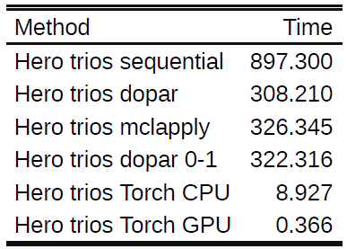
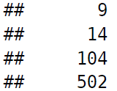
CPU VS GPU RESULTS
Foreach – dopar on transformed dataset produces same result but slightly more time for execution (as more iterations to do)
Parallelized Torch library used to perform Tensorflow einsum operations optimizes the calculation speed of code even on double the iterations than before
Parallelized torch library to calculate einsum on GPU yields an even better outcome
Steps to achieve operation:
i) convert df to tensor, select device = ‘cpu’ or ‘gpu’
ii) execute the einsum
iii) find position of argmax C(i,j,k)
iv) Enforce the condition of k>j>i to avoid repetitions
RESULT:

Slide 9
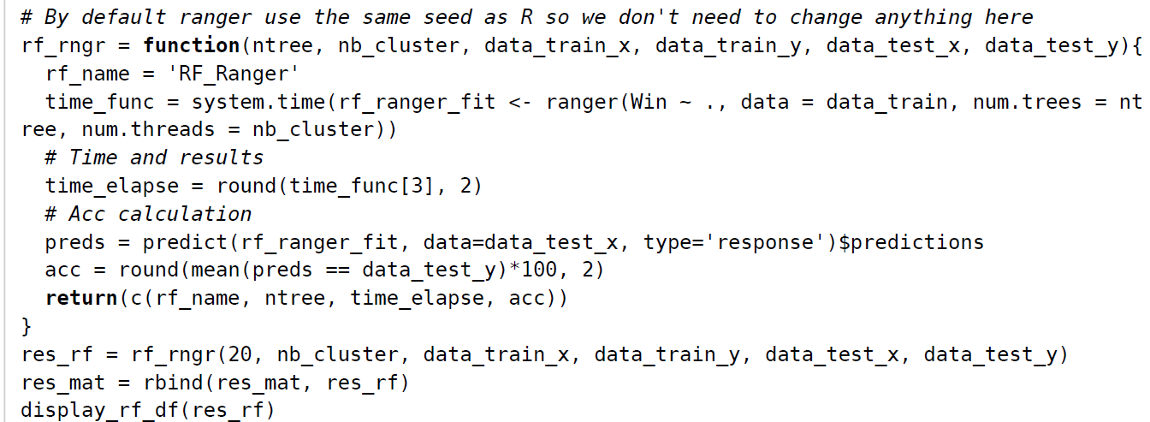
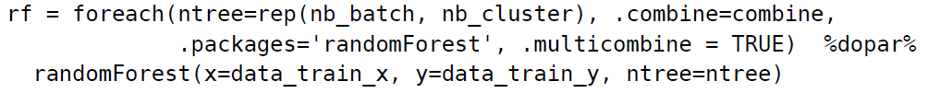

RANDOM FORESTS MODEL IN PARALLEL
With RandomForestSRC Package
- Calculation time = 34.57 s
With Ranger library
- Calculation time = 10.39 s
With DoParallel Package
- Calculation time = 13.23 s
Simple Random Forest Model
- Calculation time = 33.42 s

Slide 10
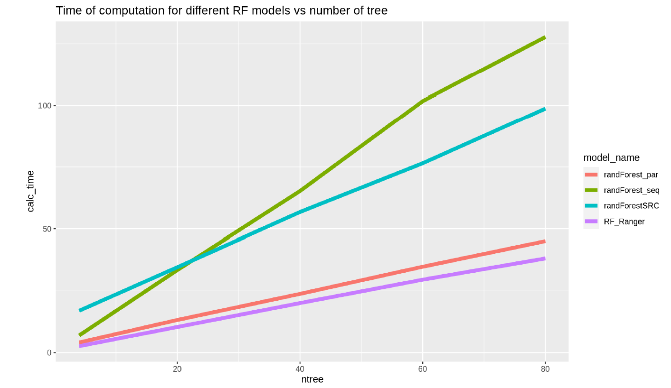
EFFECT OF NTREE ON EXCUTION TIME OF EACH PACKAGE

Slide 11
CHALLENGES AND ASPIRATION
CHALLENGES -
Code architecture design in parallel is difficult.
Where code efficiency is not important, we tend to ignore the performance issues of algorithms (data management could be difficult).
ASPIRATION -
Think in parallel – understanding the underlying algorithm and finding concurrency
Utilizing non-local resources for running and managing data.

Slide 12
CONCLUSION
It does not stipulate having an understanding of statistics or complex mathematical problems.
It allows you to instead comprehend your data in a manner that is efficient and produces the same result in much less time.
We can then tackle much more complex and computationally demanding results applicable to various fields such as Machine Learning.

Slide 13
REFERENCES
Wikipedia. (2021, April 21). Parallel computing – Wikipedia. https://en.wikipedia.org/wiki/Parallel_computing#Algorithmic_methods
Kevin Bloch-Toptal. Code Optimization: The Optimal Way to Optimize. The Optimal Way to Optimize Code Optimization | Toptal
Corporation, Microsoft, and Steve Weston. 2020. “doParallel: Foreach Parallel Adaptor for the ’Parallel’ Package.”https://cran.r-project.org/package=doParallel .(https://cran.r-project.org/package=doParallel)
Dua, Dheeru, and Casey Graff. 2017. “UCI Machine Learning Repository.” University of California, Irvine, School ofInformation; Computer Sciences. http://archive.ics.uci.edu/ml .(http://archive.ics.uci.edu/ml)
Falbel, Daniel, and Javier Luraschi. 2021. “Torch: Tensors and Neural Networks with ’GPU’ Acceleration.” https://cran.r-project.org/package=torch .(https://cran.r-project.org/package=torch)
Wright, Marvin N., and Andreas Ziegler. 2015. “Ranger: A Fast Implementation of Random Forests for High DimensionalData in c++ and r.” https://doi.org/10.18637/jss.v077.i01 .(https://doi.org/10.18637/jss.v077.i01)

Slide 14
THANK YOU

